Slide 1
Objective:
I can convert Metric Lengths

Slide 2

GIVE OUT THE BOOKS PLEASE

Slide 3
Starter
100 x 10 =
400 x 10 =
500 x 100=
90 x 10 =
40 x 10 =
690 ÷ 10 =
60 ÷ 10 =
60 ÷ 100 =
80 ÷ 100 =
85 ÷ 100 =

Slide 4
Answers
100
400
500
90
40
69
6
0.6
0.8
0.85

Slide 5
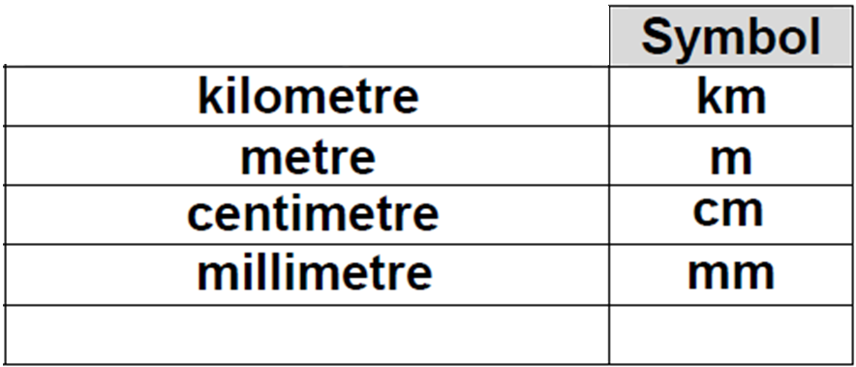
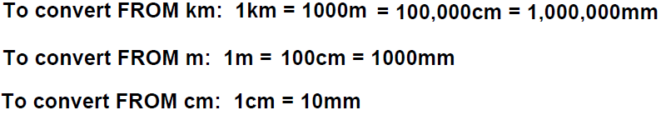

Slide 6
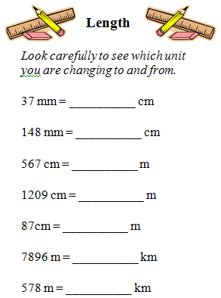

Slide 7
1) CONVERSION OF LENGTHS
2) ORDER CONVERSIONS
WHO WANTS TO BE A MILLIONAIRE GAME
1)CONVERSION OF LENGTHS
2) WORDED QUESTIONS
3) INVESTIGATION
PAST PAPER QUESTIONS

Slide 8
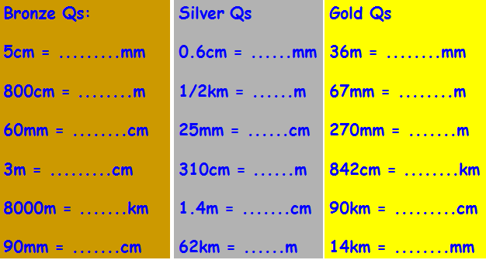

Slide 9
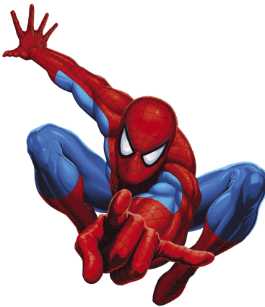
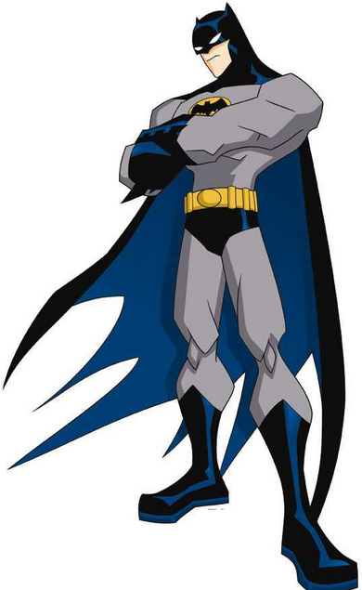
COLLECT THE BOOKS PLEASE
COLLECT ANY RUBBISH PLEASE

Slide 10


Slide 12



CONVERT TO MM
CONVERT TO CM
CONVERT TO M
You are working at grade E

Slide 13
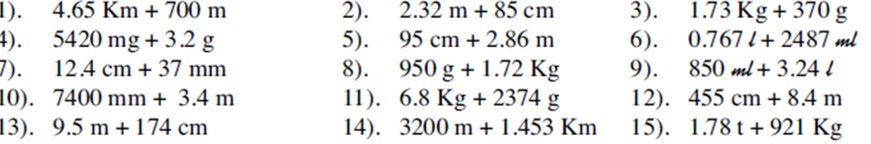

Slide 15
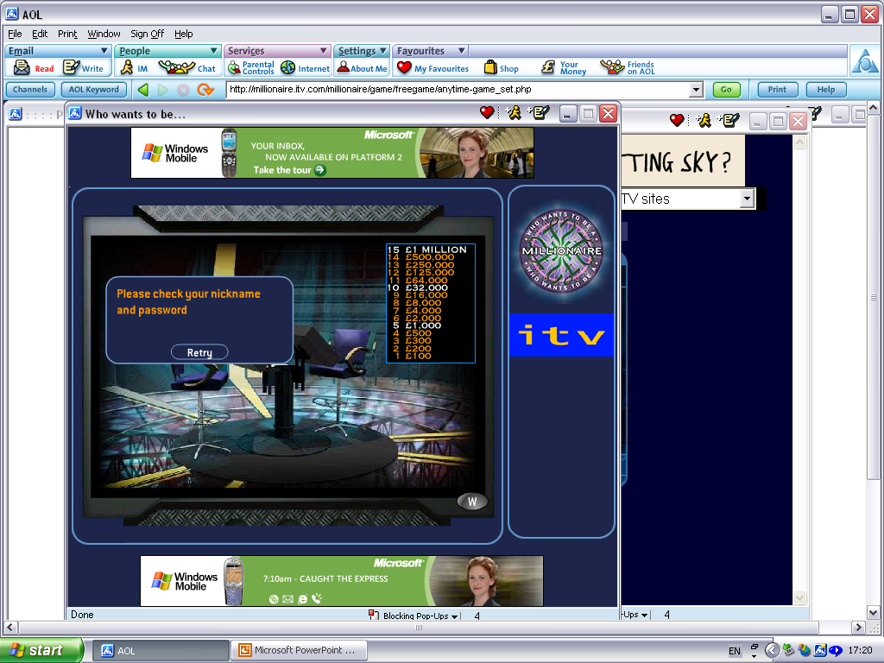
Answer questions
on the subject of
Measures
Let’s Begin

Slide 16

Question 1 for £100
How many metres are there in 3.9km?
50:50
A. 3900
B. 390
C. 39
D. 0.0039

Slide 17
Question 2 for £200
How many mm are there in 99cm?
50:50
A. 9.9
B. 0.99
C. 9900
D. 990

Slide 18
Question 3 for £300
How many cm are there in 88m?
50:50
A. 88
B. 8800
C. 88000
D. 880

Slide 19
Question 4 for £500
How many cm are there in 7.1m?
50:50
A. 71
B. 0.71
C. 710
D. 7100

Slide 20
Question 5 for £1000
How many grams are there in 9.5 kg?
50:50
A. 95000
B. 9500
C. 950
D. 95

Slide 21
Question 6 for £2000
How many grams are there in 1.8kg?
50:50
A. 1800
B. 18
C. 0.018
D. 180

Slide 22
Question 7 for £4000
How many cm are there in 8.1m?
50:50
A. 81
B. 0.81
C. 810
D. 0.081

Slide 23
Question 8 for £8000
How many mm are there in 11 cm?
50:50
A. 110
B. 1.1
C. 1100
D. 0.11

Slide 24
Question 9 for £16000
What units you use to measure the length of a fly’s wing?
50:50
A. m
B. mm
C. g
D. cm

Slide 25
Question 10 for £32000
Convert 63 mm into cm?
50:50
A. 6.3
B. 0.63
C. 630
D. 630

Slide 26
Question 11 for £64000
What units would you use to measure the length of a car?
50:50
A. mm
B. cm
C. m
D. km

Slide 27
Question 12 for £125000
What units do you use to measure weight?
50:50
A. litres
B. metres
C. grams
D. pounds

Slide 28
Question 13 for £250000
What is 6300g in kg?
50:50
A. 0.63
B. 6.3
C. 630
D. 63

Slide 29
Question 14 for £500000
What could be used to measure distance?
50:50
A. ounces
B. inches
C. pints
D. gallons

Slide 30
Question 15 for £1MILLION
How long is a km in metres?
50:50
A. 1000
B. 10 000
C. 10
D. 100

Slide 31
ASK THE AUDIENCE
Write the letter of your chosen answer on your whiteboard.

Slide 32
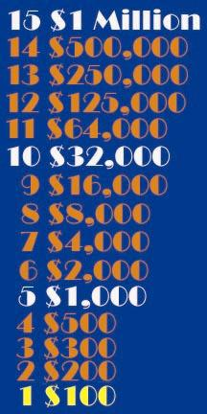
Congratulations!
You have won
£100
£100
Would you like to try for
£200
?

Slide 33
Congratulations!
You have won
£200
£200
Would you like to try for
£300
?

Slide 34
Congratulations!
You have won
£300
£300
Would you like to try for
£500
?

Slide 35
Congratulations!
You have won
£500
£500
Would you like to try for
£1000
?

Slide 36
Congratulations!
You have won
You are guaranteed
£1000!
You are guaranteed
£1000!
Would you like to try for
£2000
?

Slide 37
Congratulations!
You have won
£2000
£2000
Would you like to try for
£4000
?

Slide 38
Congratulations!
You have won
£4000
£4000
Would you like to try for
£8000
?

Slide 39
Congratulations!
You have won
£8000
£8000
Would you like to try for
£16000
?

Slide 40
Congratulations!
You have won
£16000
£16000
Would you like to try for
£32000
?

Slide 41
Congratulations!
You have won
You are guaranteed
£32,000!
You are guaranteed
£32,000!
Would you like to try for
£64,000
?

Slide 42
Congratulations!
You have won
£64,000
£64,000
Would you like to try for
£125,000
?

Slide 43
Congratulations!
You have won
£125,000
£125,000
Would you like to try for
£250,000
?

Slide 44
Congratulations!
You have won
£250,000
£250,000
Would you like to try for
£500,000
?

Slide 45
Congratulations!
You have won
£500,000
£500,000
Would you like to try for
1 Million
?

Slide 46

Congratulations!
You have won
£1,000,000
£1,000,000

Slide 47
PHONE A FRIEND
Which student in class would you like to ask for help?

Slide 48
I’M SORRY
That is not the
correct answer!

