Slide 1

Fine Motor Skills
Jillian Buckley, Occupational Therapist
Demonstration Project on In-school and Early Years Therapy Support

Slide 2
Outline of Workshop
Definition and importance of fine motor skills
Underlying factors for fine motor development:
  postural control (core and shoulder stability)
  hand and finger strength
  pincer grip/ in-hand manipulation
Strategies and activities to promote fine motor development
Tips for handwriting
Tips for scissor skills

Slide 3
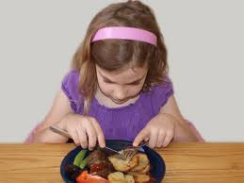
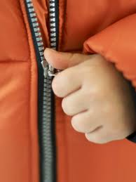

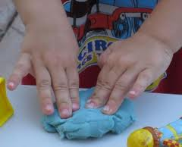
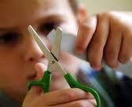
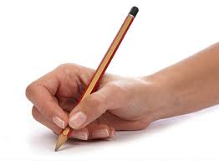

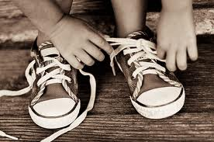
What do these activities have in common?

Slide 4

Importance of Fine Motor Skills
The ability to control and coordinate the small muscles in the hand for precise movements.
Essential for performing everyday skills as well academic skills.
Facilitate independence, eg dressing, feeding, toileting.
Difficulties can lead to frustration, avoidance of activities, decreased self esteem, difficulty with school and play tasks.

Slide 5
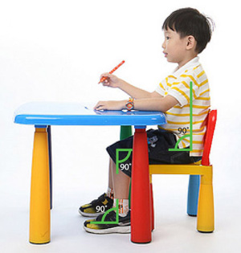

Postural Control
A good seated position helps the child to be stable, to concentrate and to use their hands effectively.
At the table:
  Feet flat on the floor
  Hips/knees at 90°
  Table height, about 2 inches above the level of the elbows
What to look for:
Is the child slumped over the desk?
Is the child leaning to one side or sitting awkwardly?
On the floor:
  Cross legged sitting more stable than long sitting or side sitting
  Back supported against a wall may be better

Slide 6
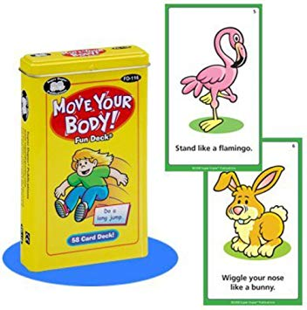

Core Stability
The ability of the muscles of the trunk and lower back to hold the body upright against the resistance of gravity.
Can lead to poor posture which affects fine motor skills.
How to help:
Bridges
Animal walks
Fun deck cards
PE activities
Yoga activities
Push-ups
Sit-ups
Notes:
Imagine trying to paint a wall while dangling from a rope or working on a wobbly stepladder. The paint will go everywhere and it will be really hard to get the paint to land on the right spot.
You need a stable base in order to paint easily and effectively.

Slide 7
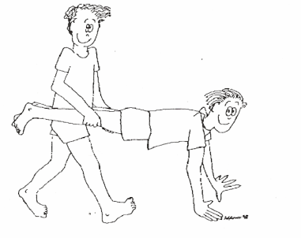
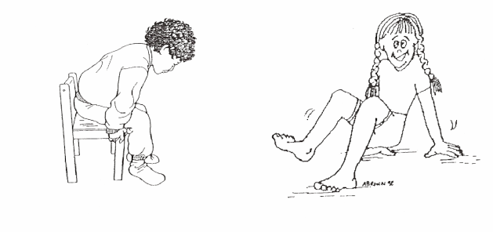
Arm and Shoulder Stability
Children need to have stability at the trunk and shoulder so that they can use their hands effectively.
What to look for:
Keeps elbows tucked
Shoulders raised when writing or using scissors
Rests elbow on chair when raising arm
Supports raised arm with other hand
Trouble with large movements on the blackboard
Moves their paper during writing / drawing tasks instead of their arm
Complains their arm hurts or it gets tired
How to help:
Large Motor Games
  Push-pull activities, throwing/catching
Weight-bearing Activities
  Chair push ups, wall push ups, lying on tummy on the floor when doing activities
  Wheelbarrow walks
  Crab walks, crab football
  Animal walks
Work on vertical surfaces
Arm spirals

Slide 8
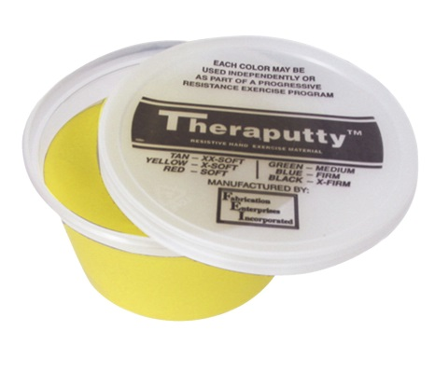
Hand and Finger Strength
Required for everyday activities such as doing up buttons and zips, climbing monkey bars, using scissors or cutlery.
Helps to develop the stamina and endurance to complete activities such as writing a full page.
What to look for:
Fatigues easily when completing a piece of writing.
Difficulty opening packets and bottles.
Difficulty holding their pencil/ scissors correctly.
Shaking or rubbing hands, especially during writing/ cutting activities.
How to help:
Playdough/ Theraputty
Lego or other construction activities
Pop bubble wrap
Rolling marbles up/down/across a wall or table with index, middle and thumb pads
Clothes peg/ tweezers/ tongs activities
Using stencils when drawing

Slide 9
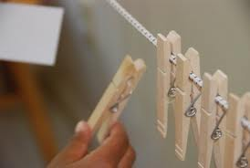
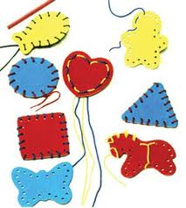
Pincer Grip/ In-Hand Manipulation
The ability to grasp small objects with the thumb and index finger, and move objects within the hands effectively.
This is an important part of fine motor development.
How to help:
Clothes Pegs/ Tongs/ Tweezer games
Pinching playdough/ Theraputty
Pick up coins to post in a money box – pick up few coins at a time
Threading small beads
Tearing and scrunching paper – try thicker paper to increase the challenge
Flip double sided crayons
Ask child to walk up and down pencil
What to look for:
May use both hands for activities that would usually require only one
Unnecessarily stabilising an object against their body or an external support to get the job done
Whole hand movements when writing or drawing
Difficulty picking up very small items or holding pencil
It is a pre-writing skill and necessary for holding and manipulating a pencil

Slide 10

Hand Dominance
The ability to use a preferred hand for activities that require fine movements with accuracy and power.
How to help:
  Observe closely!
  Look at which hand they favour to hold their pencil or spoon
  Make sure to offer items at the child’s midline
  Sometimes children switch hands during tasks and it is important to consider midline crossing difficulties

Slide 11
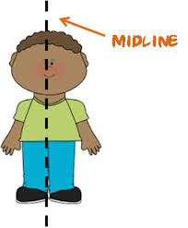
Midline Crossing and Bilateral Integration
Bilateral integration is the ability to use the two sides of the body at the same time in a controlled and organised manner. These skills are necessary for handwriting and using scissors.
The midline is an imaginary line drawn down the middle of our body. Movements across the body should be smooth and spontaneous. Children need to be able to use their arms and legs and eyes across their body (midline) e.g. to write across the page, read or use cutlery.
Notes:
Bilateral integration- think of babies-two hands together in middle
As we develop-first use 2 sides of body together-crawling
Then start to specialise-one hand writes, one stabilises page
Until both sides work together effectively, they do not specialise and so are not as skilled
Midline crossing- commonly see children who will use their right hand for placing beads until they reach the middle where they then switch to using their left hand

Slide 12
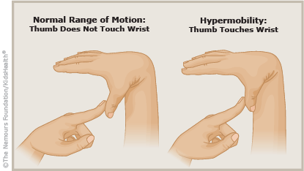
Hypermobility
Joints that can extend beyond a normal range of movement.
Due to connective tissue around the joint being stretchier than usual.
Affects how a child grasps and controls small objects or tools and can lead to fatigue/pain.
Most ballet dancers and gymnasts have a degree of joint hypermobility - which means that you can be hypermobile, strong, active and fit.
How to help :
Strengthening activities
Thicker pencils/ pencil grips
Adapted scissors
Develop typing skills if necessary
Notes:
Hypermobility is more common than you may think
Ballet dancers-not all bad news, but the key is strength and stability

Slide 13
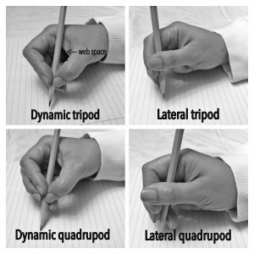
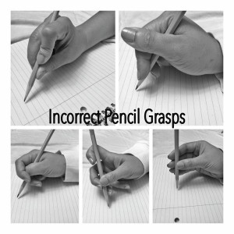
Pencil Grasp
Development of pencil grasp begins before junior infants and continues to 1st/2nd class.
The most effective pencil grasp allows the fingers to move without moving the wrist or whole arm.
Incorrect pencil grip leads to muscular tension, fatigue or unnecessary stress on our joints. This can make handwriting more difficult.

Slide 14
Functional Pencil Grasp
Teach the tripod grip in the following manner: Place the pencil on the desk with the lead pointing towards your body.
Pinch the pencil close to the tip with the tip of the thumb and index fingers
Flip the pencil over to rest in the space between your thumb and index finger
Tuck the middle finger under the pencil
Pinch Flip Tuck
How to help with pencil pressure:
Look at the pencil grasp
Writing on a vertical surface
Use a wider pencil or softer pencil (eg 4B)
Writing on carbon paper, tissue, towel, sandpaper, foam mouse mat or foil
Roll playdough around the pencil to give feedback of how tightly the pen is being held

Slide 15
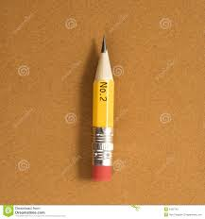
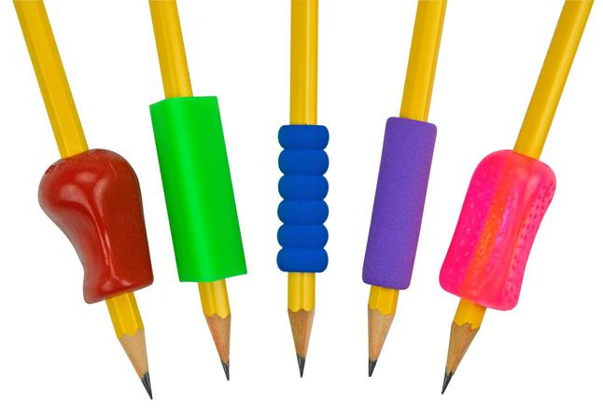
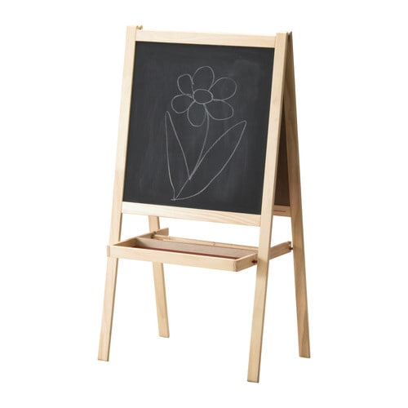
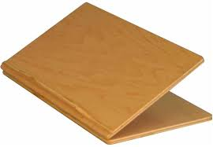
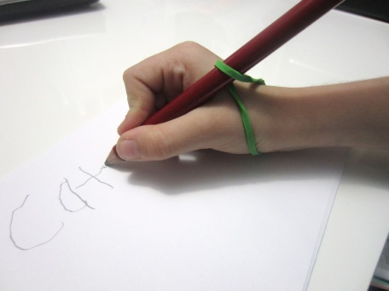
Developing Effective Pencil Grasp
Practice fine motor and strengthening activities
Use short/broken (1”) wide pencils/ crayons/chalk to improve grasp
Use triangular/thicker pencils
Plastic pencil grips
Use a vertical or upright surface
Try using elastic band around length of pencil
Notes:
After the age of 8 or 9 motor patterns are well established
Very difficult to alter the way a child holds their pencil after this age
Compensatory strategies may be used instead

Slide 16
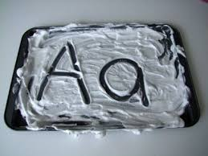
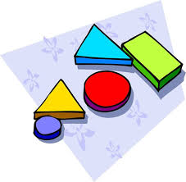
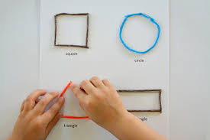
Pre-Writing Shapes
Developmentally we learn: vertical and horizontal lines, then circles and then diagonals.
The pre-writing shapes include: l - O + □ / \ x ∆
Need to master shapes before progressing to forming letters and numbers.
Make large shapes, e.g. in the air, on a whiteboard, on the floor. It will then be easier to make the shapes smaller.
Use a Multisensory Approach
  Use different paper (e.g. foil, sandpaper) and different tools (e.g. paint)
  Write in sand, shaving foam, finger paint
  Vibrating pen, write on the child’s back or hand and guess the shape
  Follow the leader to form shapes
  Wet dry try technique
  Wikistix or pipecleaners
  Teach letters in groups of similar formation e.g. “Handwriting Without Tears” Programme

Slide 17
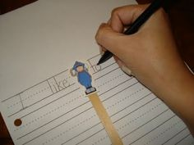
Ideas for Handwriting
Activities to improve poor spacing
Drawing lines or circles between words
Encourage the child to say “space” or “nothing” as they write and make spaces
Challenge the child to make a raisin or M&M space between each word
Use a finger spacer
Activities to improve pencil control/ fluency
Letter patterns
Mazes
Drawing a snail or tornado
Tracing over lines
“Write from the Start” Programme

Slide 18
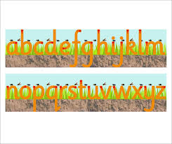

Ideas for Handwriting
Letter sizing and writing on the line
Practice writing within the lines on a large scale
Use paper with a midline
Use raised lined paper
Highlight half the line horizontally
Use colours - blue on the top for the sky, green in the middle for the grass and brown underneath for the earth
Reversals
For 1st/ 2nd class students who consistently reverse letters introduce cursive early to help correct this
Encourage left and right awareness
Work on one reversal at a time
Use rhymes, words, stories to help the child remember the different letters
Give a visual cue at the desk for commonly reversed letters

Slide 19
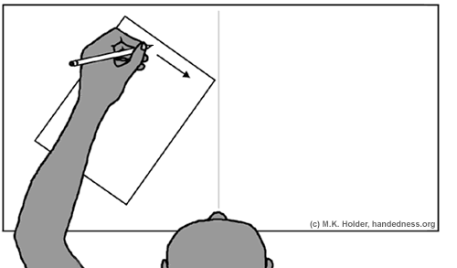
Left Handedness
Difficulty seeing their handwriting since the hand covers their writing.
Writing in a less natural direction from left to right across the midline.
How to help:
Avoid sitting a left handed child on the right side of a right handed child
Position the paper to the left of the midline
Tilt the paper clockwise so that the edge of the page is parallel to the child’s forearm– use masking tape to mark the position on the desk
Encourage the child to steady the paper with their right hand in the middle or towards the right edge of the paper
The left forearm should remain parallel with the sides of the paper
Hold the pencil slightly higher up on the pencil to allow more seeing room

Slide 20


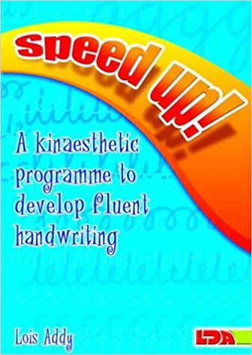
Handwriting Programmes
Handwriting Without Tears
Developmental sequence - capitals then lower case
Based on 3 stages of learning- imitating, copying, independent writing
Letters grouped in similar formation
Multisensory approach
Write From The Start
Developing fine motor and perceptual skills for handwriting
Speed Up
For older children who have slow / laboured handwriting

Slide 21
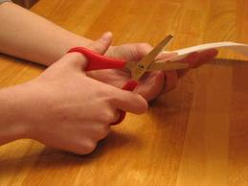
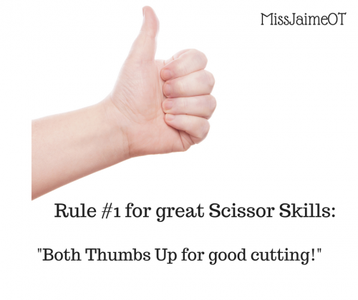
Scissors Skills
The correct scissor grasp is with the thumb and middle finger in the holes, the index finger on the outside to stabilise, and the ring and little fingers curled into the palm
‘Thumbs up’
Developmental Sequence
Controlled opening and closing of scissors
Random snipping of a variety of materials
Cutting along a short continuous line
Stopping at a specific point
Cutting out curved lines
Cutting out simple geometric shapes with angles and corners
Cutting out complex shapes

Slide 22
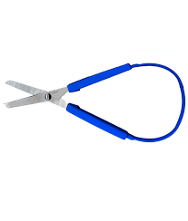
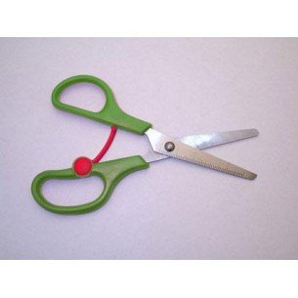
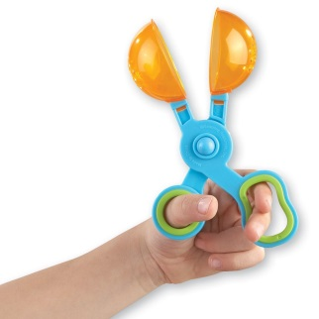
Improving Scissors Skills
Pre-cutting activities
Two thumbs up position (for the paper and the scissors), crocodile hand actions
Using clothes pegs or tongs to pick up objects, move them from one place to another, & release them, e.g. Avalanche game
Tearing paper or cardboard – a collage picture can be made from small pieces of torn paper
Scoop scissors
Adapting scissors activities
Try different types of scissors
Put mark on all scissors (eg nail polish) to show where thumb goes
Practice cutting other materials e.g. playdough, straws
What is being cut? Use thicker/smaller pieces of paper
Simplify the task by drawing a simple square or circle around it to cut
Make lines thicker and gradually narrow
Use of stickers, dots or hole punches to cue turning corners

Slide 23

Thank you for listening!
Notes:
Few minutes for questions
Parent advise clinics for individual advice

